Slide 1
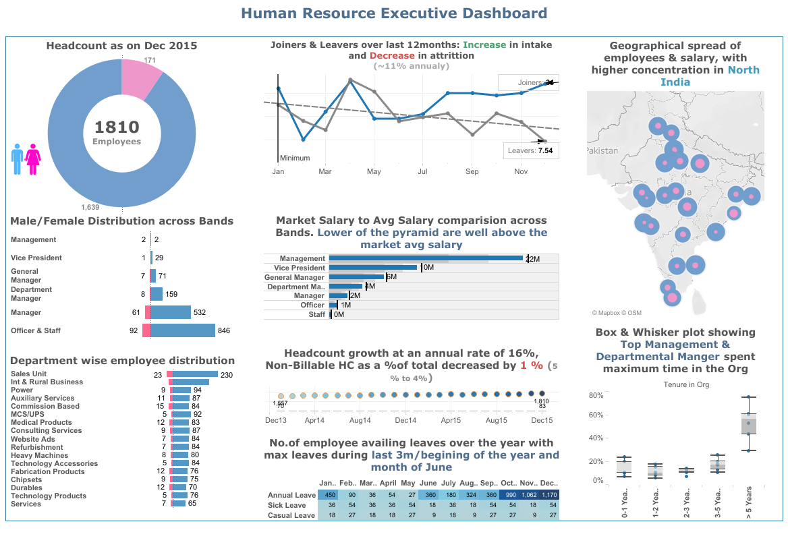
Employee Retention Dash Board analysis
Mel Schwan
DDS Analytics, Inc.

Slide 2

Predicting Employee departure
Our mission is to analyze and predict the employee that has a high potential for leaving the corporation

Slide 3
Agenda
Analysis of the attrition dataset
Basic conclusions
Any trends in organizations and job type
What data points can predict an employee departure
Next steps

Slide 4


Retaining employees
Predict when they might be leaving and correct areas that may prevent this
Notes:
Notes notes

Slide 5
Frito lays employment data Employees in Dataset - 1470 columns 35
Age
Attrition
Business Travel
Daily Rate
Department
Distance From Home
Education
Education Field
Employee Count
Employee Number
Environment Satisfaction
Gender
Hourly Rate
Job Involvement
Job Level
Job Role
Job Satisfaction
Marital Status
Monthly Income
Monthly Rate
Num Companies Worked
Over 18
Over Time
Percent Salary Hike
Performance Rating
Relationship Satisfaction
Standard Hours
Stock Option Level
Total Working Years
Training Times Last Year
Work Life Balance
Years At Company
Years In Current Role
Years Since Last Promotion
Years With Curr Manager

Slide 6
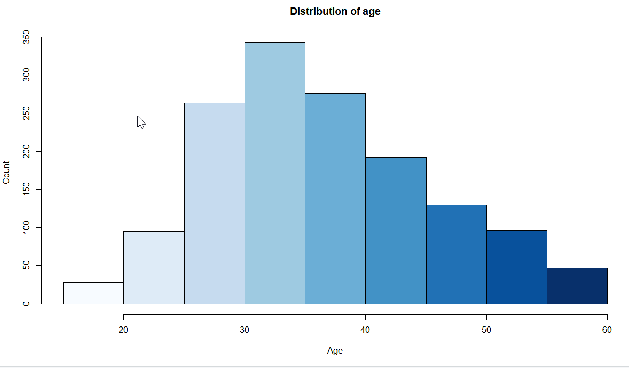
Average age of employee

Slide 7
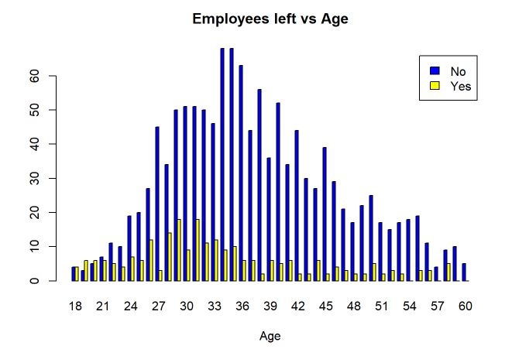
What age do they leave

Slide 8
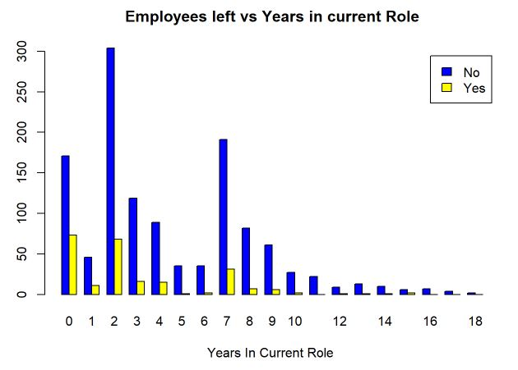
Current postion timeline

Slide 9
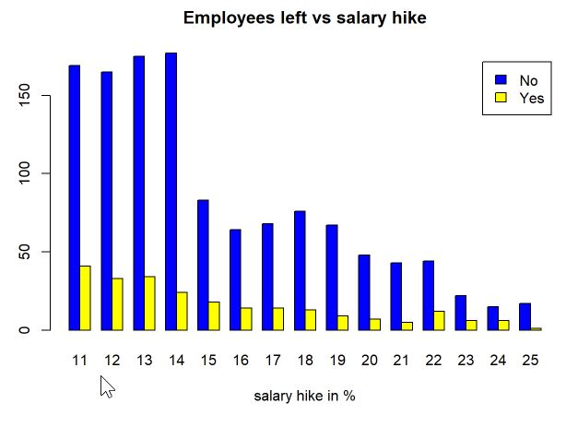
Does salary play a factor

Slide 10
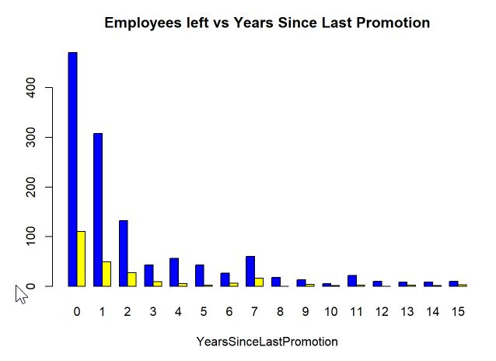
What does a promotion do for attrition

Slide 11
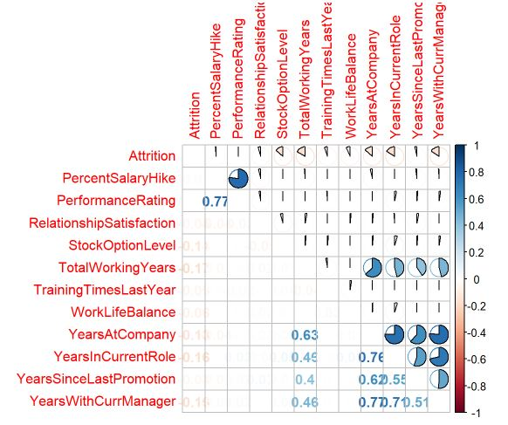
Correlation between all factors

Slide 12
We chose the top four factors in attrition
Years In Current Role
Job Role
Monthly Income
Years Since Last Promotion

Slide 13
What can our attrition model do for you?
Constant monitoring of employee data
Show trends of departures
Predict when an employee will leave
80% current accuracy
Interdict departure saving rehiring and training cost

Slide 14
Summary and Opportunities
We can predict departures and save money
With refinement accuracy will reach 95%
Frito lays will save estimated $80 million/yr
Next Steps
Sign a one year service agreement and start saving money

Slide 15
Thank you
For questions contact
Mel Schwan 454-444-3545
All content of this presentation available at:
https://github.com/schwan1/CaseStudy2DDS

